Slide 1

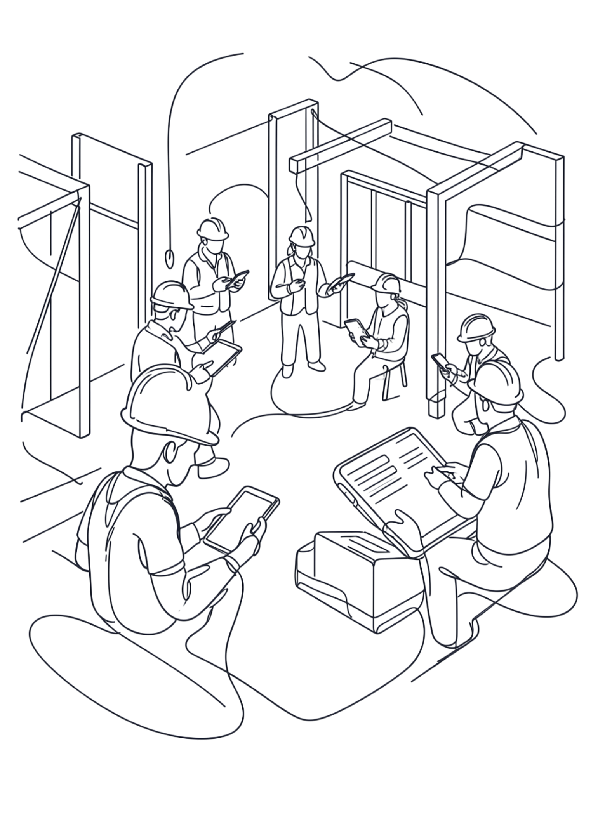

Capstone Project
CHECK-IN-OBRA – SECCIÓN: 008V
Integrantes:
Bryan Moscoso
Juan Cuevas Elizabeth Soto

Slide 2
Check-In-Obra
An integrated enterprise software solution that digitizes on-site toolhouse tracking, automates material take-off calculations, and controls construction budget lifecycles in real time.
COMPUTER ENGINEERING CAPSTONE PROJECT

Slide 3

What Is Check-In-Obra?
RESTful Backend API
Native Android App
Enterprise-grade server handling all business logic and data operations.
On-site mobile application for warehouse keepers and site workers.
Real-Time Digitization
Replaces paper logbooks with automated digital records and instant alerts.

Slide 4

Who Built It & Who It Helps
The Team
Developed by a three-member Computer Engineering team under the Scrum agile framework.
Who It Serves
Site workers — faster tool checkouts
Warehouse keepers — digital inventory management
Site managers — real-time cost and asset visibility

Slide 5
Target company – Constructora Nuevo Horizonte SpA
Key needs:
Digitize the registry of tools and materials.
Monitor the status of resources in real time.
Reduce errors associated with manual record-keeping.
Detect losses and consumption variances.
Improve control over construction project budgets.
Who will use the solution?
Workers → Tool requests and returns
Warehouse staff → Inventory and loan tracking via QR codes
Site managers → Resource and cost supervision
Administration → Data for decision-making

Slide 6
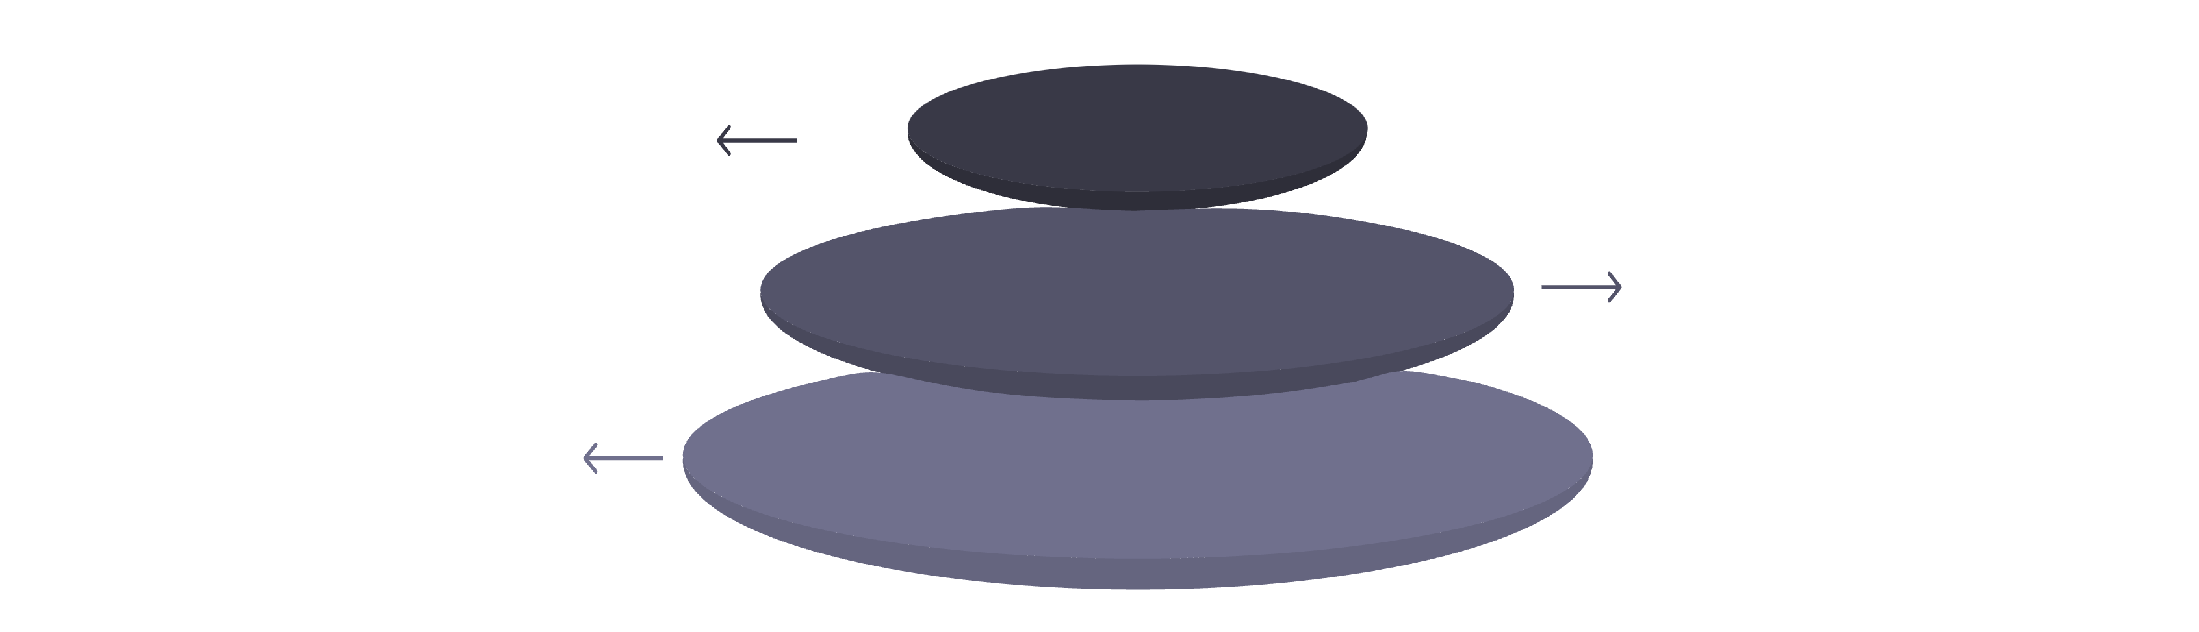
Technical Architecture
Backend
Java 21, Spring Boot 4.1.1, PostgreSQL 16
API Layer
RESTful endpoints, multi-tenant isolation
Mobile Client
Flutter 3.47.1, Riverpod state management, Dio
Secure and scalable architecture that enables the management of multiple construction projects while keeping their data separate.

Slide 7
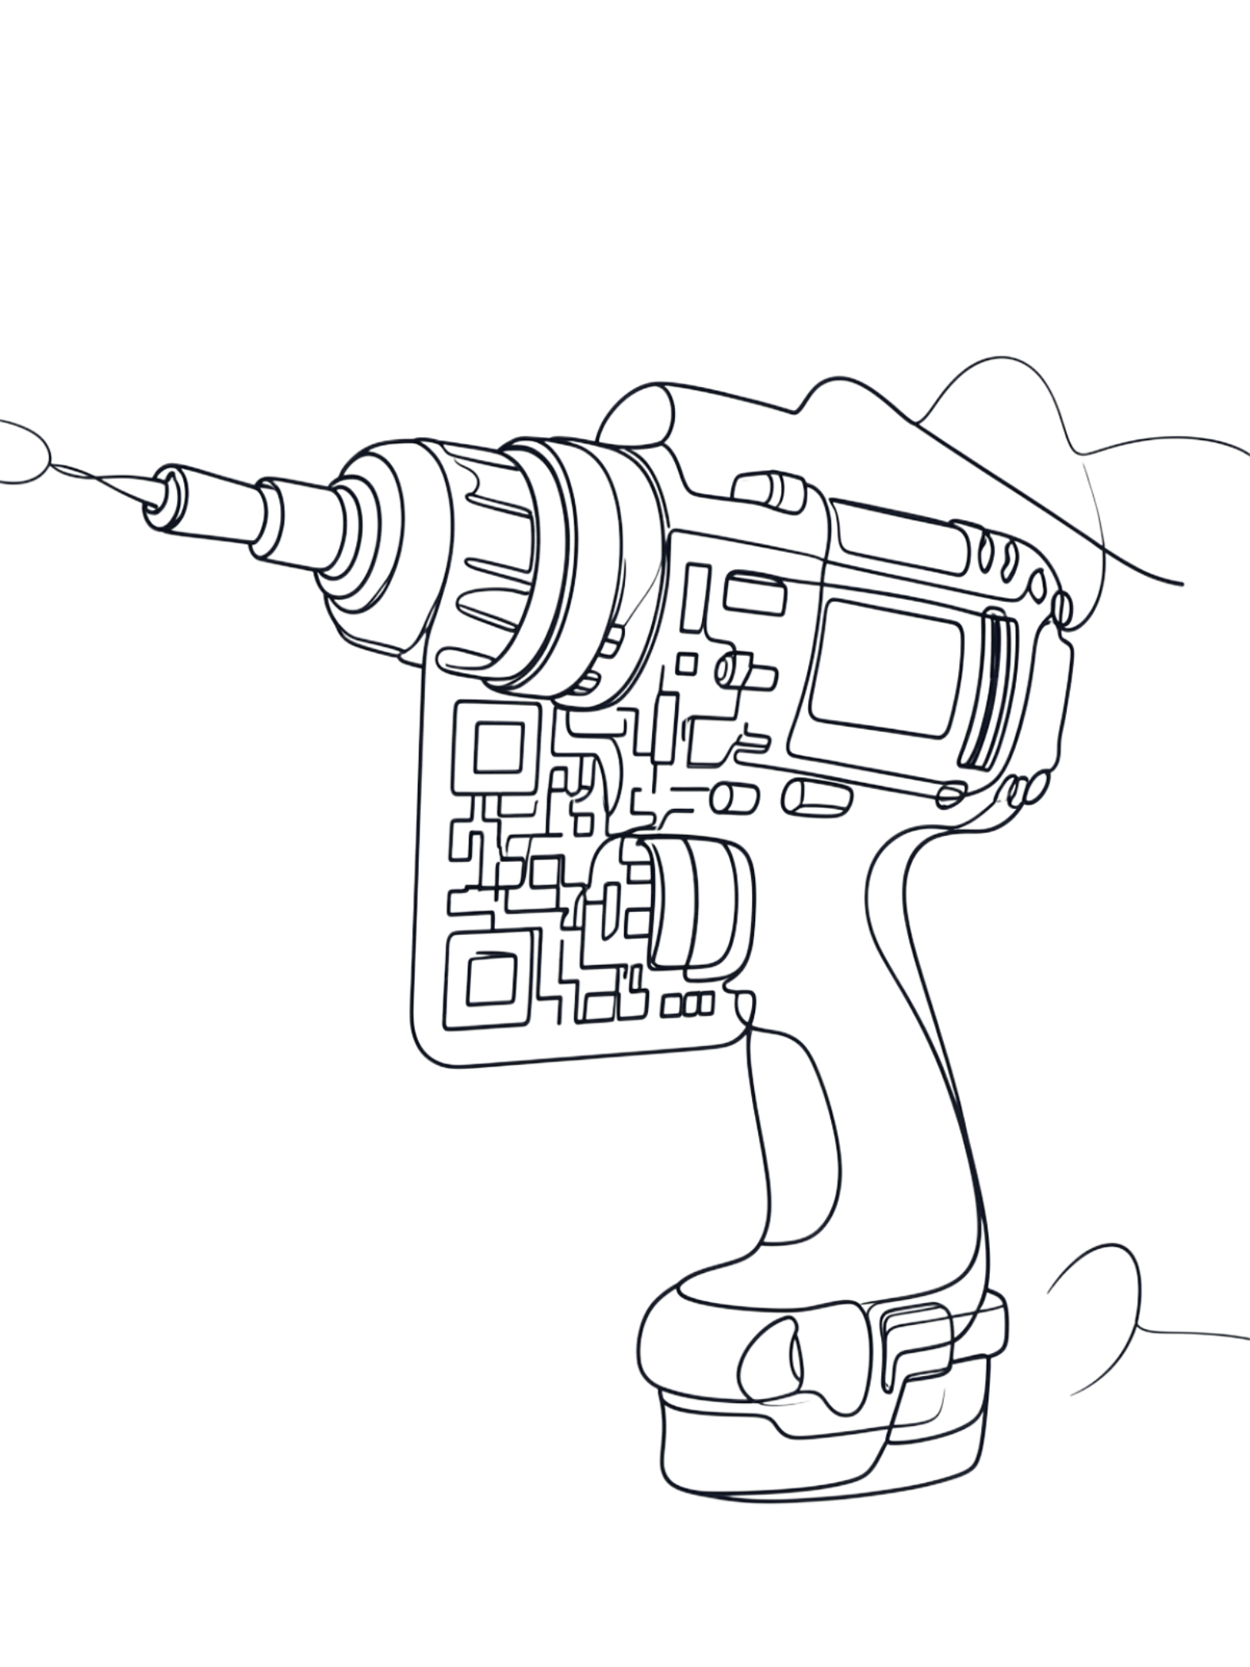
How does it improve work on the
construction site?
QR Code Scanning
Warehouse keepers scan tool QR codes and worker IDs to register dispatches and returns in seconds.
Real-Time Inventory States
Tools are tracked as DISPONIBLE, PRESTADA, or MANTENCION at all times.
End-of-Shift Alerts
Automatic alerts trigger immediately when tools are not returned before shift end.

Slide 8
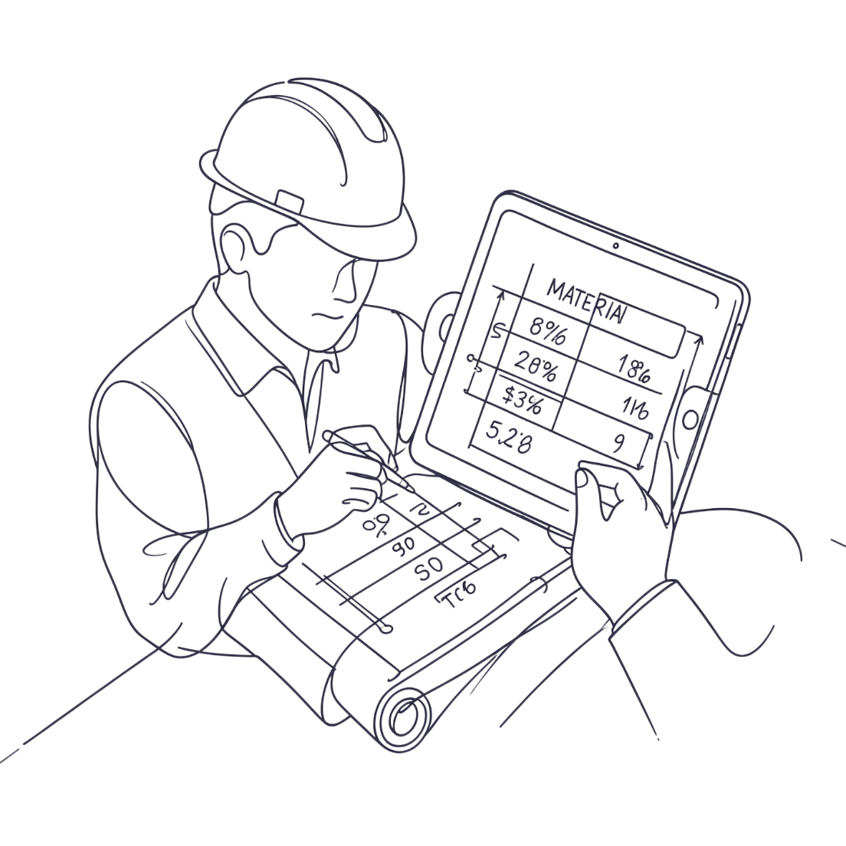
Materials control
Parametric Calculations
We automate calculations that are currently performed manually, reducing errors and administrative time.
Atomic Excel Imports
Supports structured data import via Apache POI, enabling bulk material and budget data ingestion with full validation.

Slide 9



Budget Lifecycle State Machine
DRAFT
APPROVED
FROZEN
Baseline prices entered, open for editing.
Budget validated and locked for execution.
Contract prices immutable; active deviation tracking enabled.
The immutable state machine locks baseline contract prices and tracks real consumption versus budget while the job site is active, safeguarding project profit margins.

Slide 10
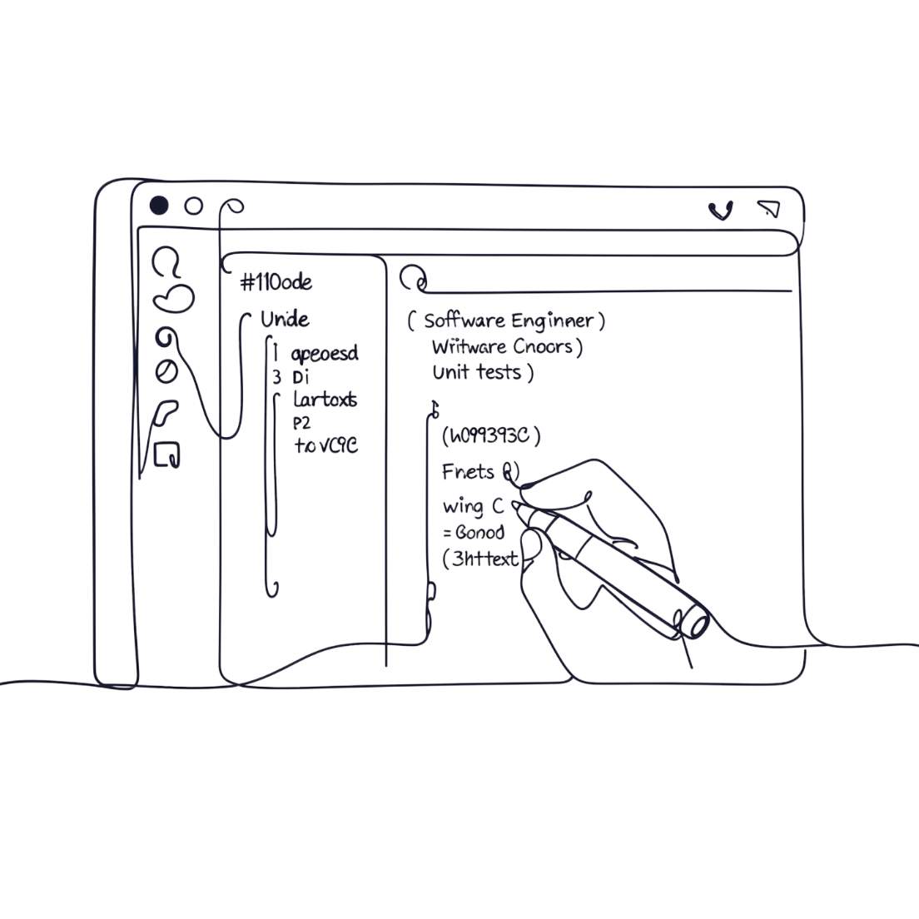
Security & Testing
Multi-Tenant Isolation
Database Migrations
Test Coverage
Backend tested with JUnit 5; mobile layer validated with flutter_test.
Strict tenant separation — unauthorized cross-tenant access returns HTTP 404.
Schema versioning managed by Flyway on PostgreSQL 16.

Slide 11

Expected impact
⚡ Checkout Speed
📄 Zero Paper Errors
Tool checkout times reduced from minutes to seconds via QR scanning.
Completely eliminates paper-logging errors with automated digital records.
🔒 Asset Protection
Stops tool shrinkage and safeguards profit margins through active deviation tracking.

Slide 12
Success metrics and expected impact
How will we measure the impact of Check-In-Obra?
⏱️ Check-in/Check-out time
Reduce tool logging time by using QR codes.
Goal: -70% in logging time
💰 Operational savings
Less time spent on manual logging and searching for information.
Goal: reduce operational costs associated with logging and tracking
📦 Losses and errors
Improved traceability of tools that are loaned out, returned, or undergoing maintenance.
Goal: decrease losses and logging errors
👥 User adoption
Simple interface to facilitate onboarding for workers and warehouse staff.
Goal: initial adaptation within ≤ 1 week.
📈 Budget control
Compare actual consumption against the budget and detect variances in a timely manner.
Goal: identify variances before project closeout.
Note: The goals will be validated through pilot tests with company users.

Slide 13

Business model
💳 Is Check-In-Obra free or paid?
Check-In-Obra is positioned as a paid solution based on a SaaS (Software as a Service) model.
The construction company would contract the service to use the platform and receive updates, support, and maintenance.
📦 What's included?
Platform Access
Mobile app for workers and warehouse staff.
Digital management of tools and materials.
Consumption and budget control.
Centralized, real-time information.
Service
Initial implementation.
User training.
Support and maintenance.
System updates.
Pricing Proposal
Monthly subscription per company or project, with a cost based on factors such as:
Number of users.
Number of active projects.
Selected features.

Slide 14

Key Takeaways
01
02
03
Integrated Solution
Enterprise Architecture
Real Business Value
RESTful API + native Android app digitizing toolhouse, materials, and budget in one platform.
Java 21, Spring Boot, PostgreSQL 16, Flutter — built for scale, security, and reliability.
Faster operations, zero paper errors, stopped asset loss, and protected profit margins.
Check-In-Obra — replacing slow paper logbooks with automated digital records, protecting construction companies against asset loss.

Slide 15
Conclusion
Check-In-Obra transforms resource management on construction sites.
The solution enables Constructora Nuevo Horizonte SpA to transition from manual processes to digital, centralized, and traceable management of its tools, materials, and budgets.
With Check-In-Obra, we aim to:
Value proposition:
Less time spent on record-keeping.
Greater control over resources.
Better decisions for the project.
Reduce registration and management times.
Improve control over tools and materials.
Access real-time information for decision-making.
Detect variances and reduce resource losses.
Facilitate adoption through a simple app and initial training.
Check-In-Obra aims not only to digitize a process but also to provide the company with a tool that generates operational and economic value.

